Slide 1


Accounts Payable Operations in Oracle E-Business Suite (EBS)
Students names:
Rawan Mohamed
Sara Hassan
Safia Adel
Nourhan Hussein
Track: Oracle Digital Accounting Specialist
Supervisor name: Mohamed Sobhy
25/10/2024
1

Slide 2
Introduction
This project focuses on implementing the Accounts Payable (AP) module in Oracle E-Business Suite (EBS) to automate and streamline financial processes.
The current manual system is leading to errors and inefficiencies, causing delays in invoice processing and payments.
The main goal is to enhance financial operations by automating vendor payments, improving accuracy, and providing real-time financial reporting.
This will help reduce errors, improve compliance, and speed up period-end closing, making the process more efficient and reliable for organizations.
2

Slide 3
Accounts Payable Operations and Reporting in Oracle ERP
1- Vendor Invoices and Billing
2- Payment Processing and Cash Management
3- Period-End Closing and Reporting
3

Slide 4
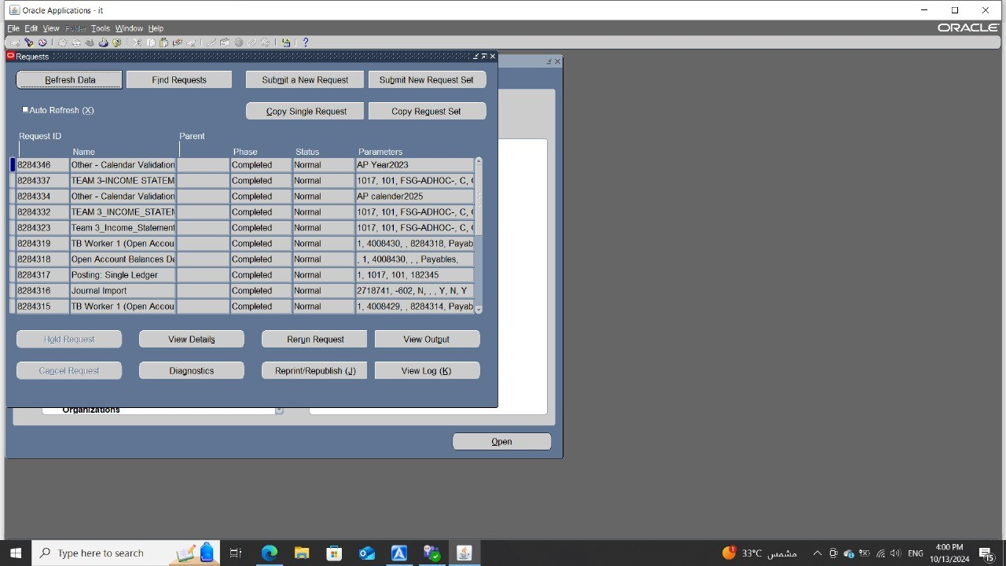
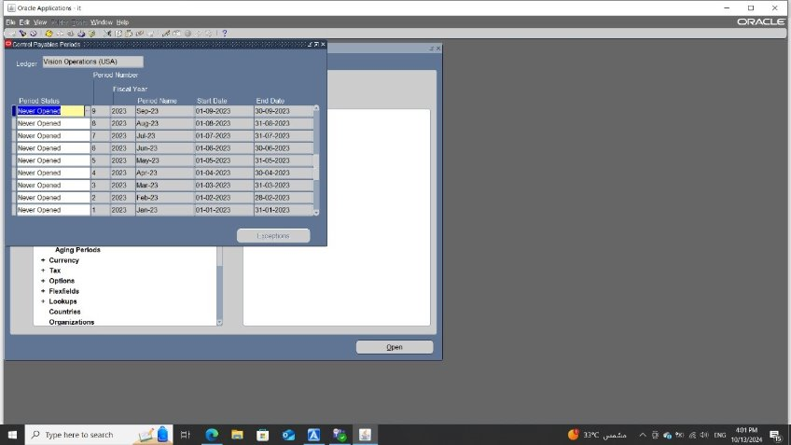
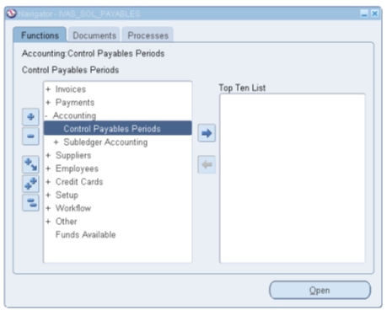
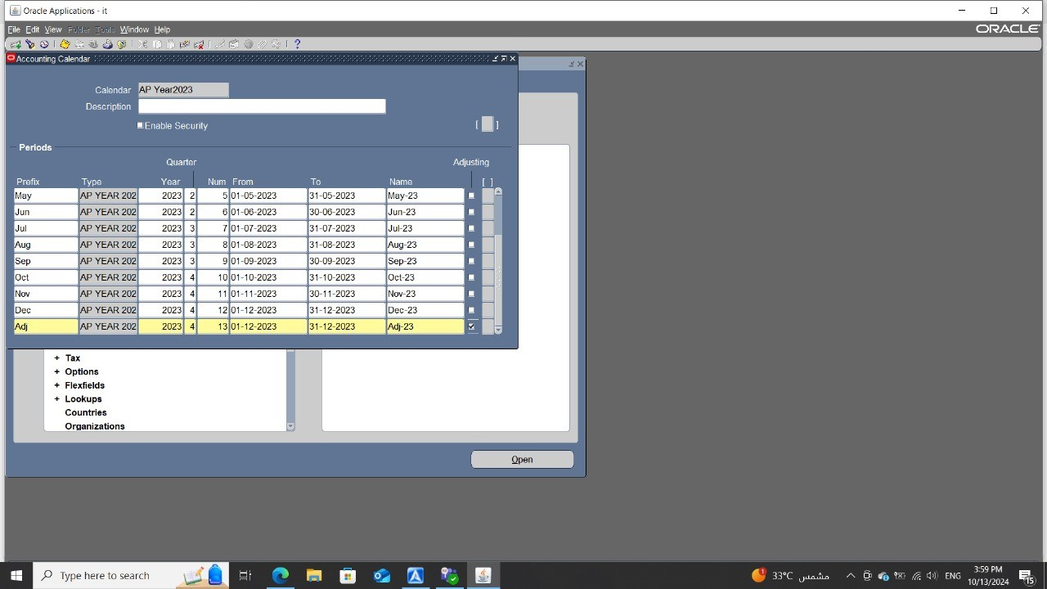
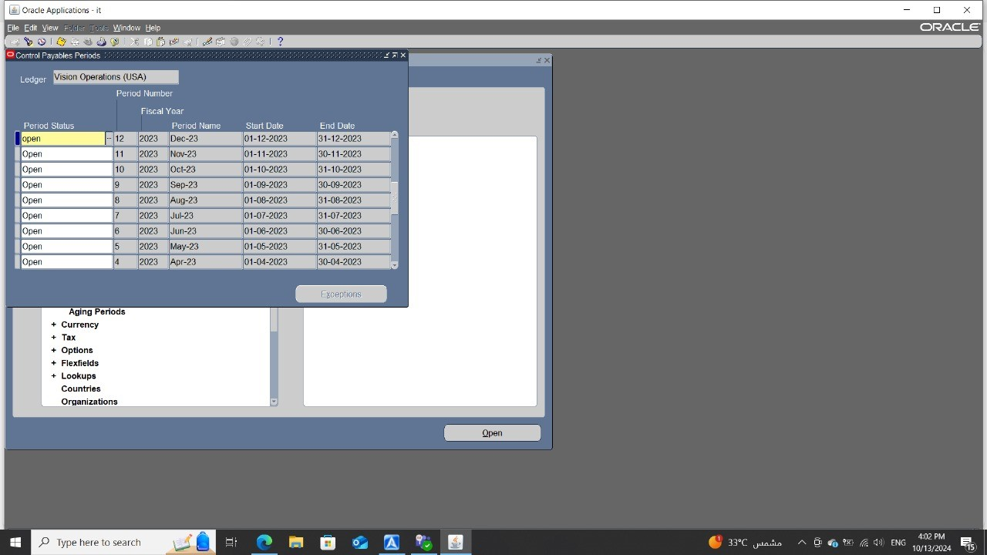
Setup for Accounts payable module
1.Define calendar
Set up > calendar
2.open Periods
Accounting > Control Payables Periods
Click on never opened > choose open
View > Request > run my request
4

Slide 5
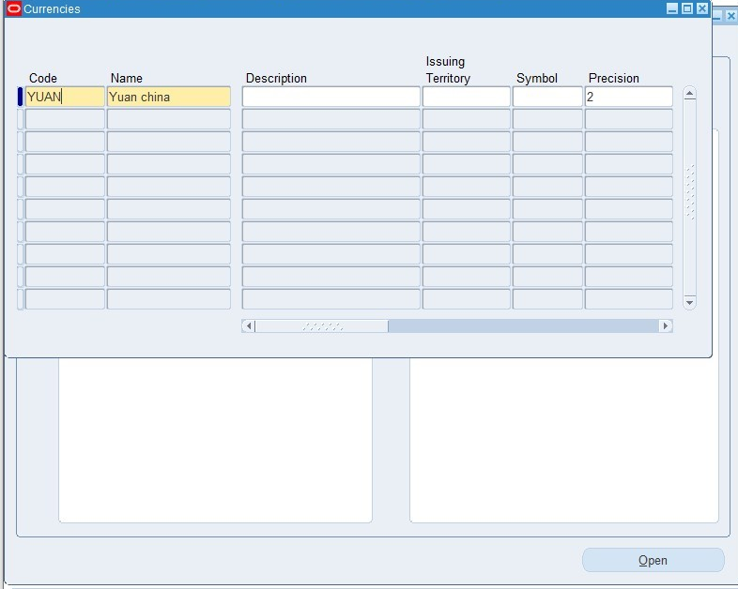
Setup for Accounts payable module
Define Currency
Set up > currency > define currency
5

Slide 6
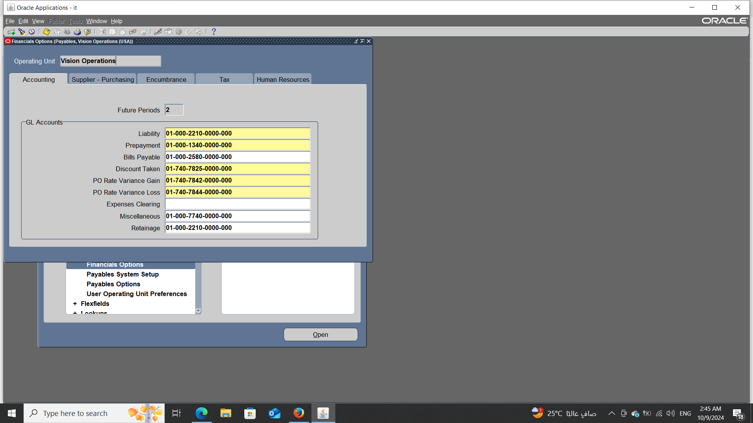
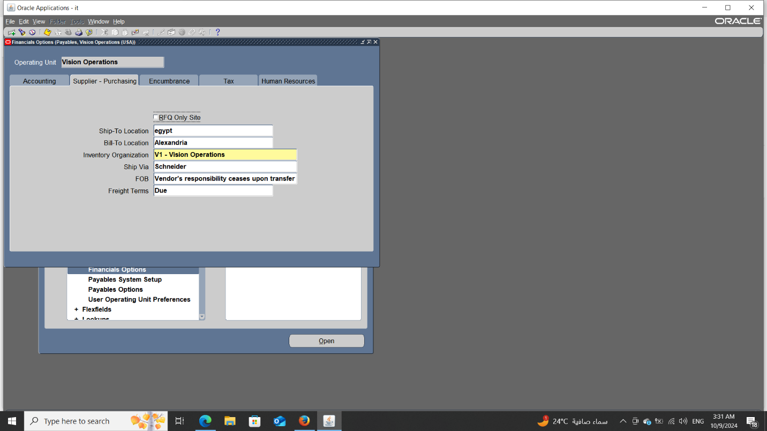
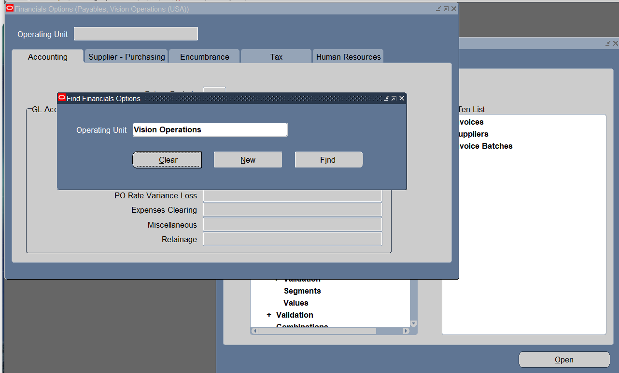
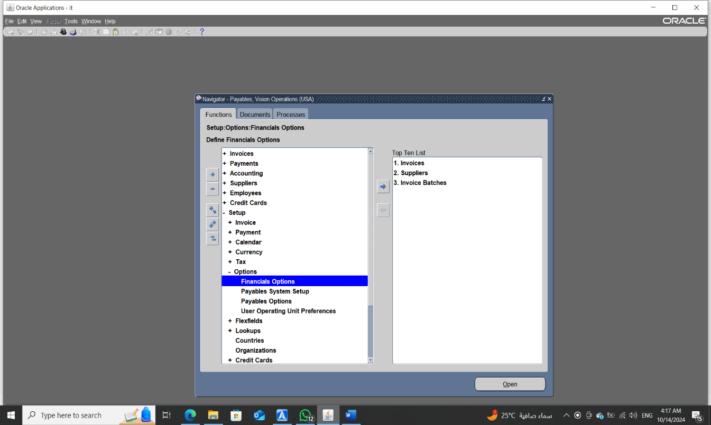
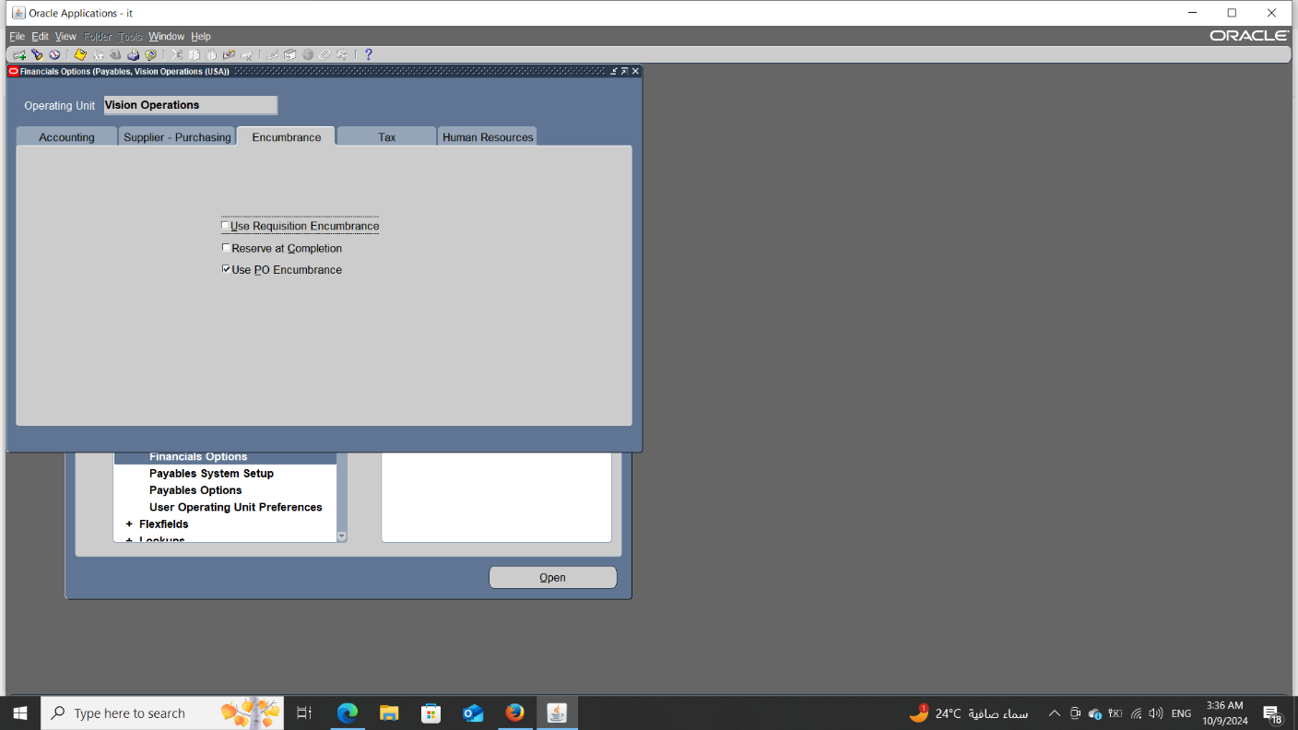
Setup for Accounts payable module
Setup > Options > Financial Options
Accounting Financials Options
Supplier - Purchasing Financials Options
Encumbrance Financials Options
6

Slide 7
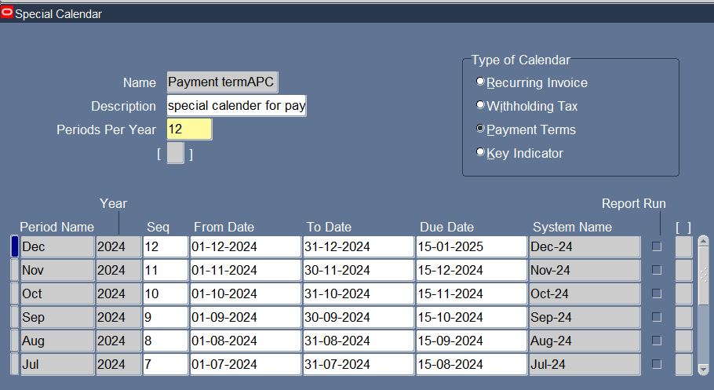
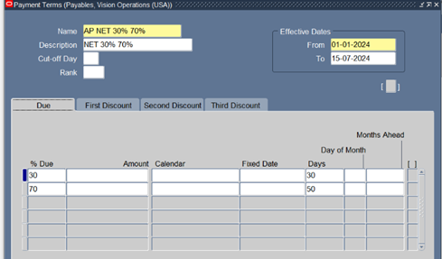
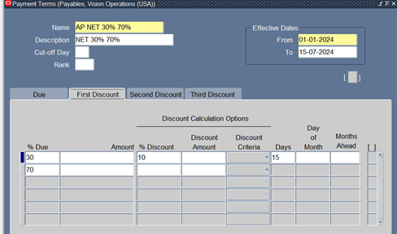
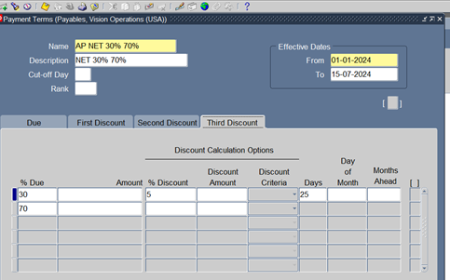
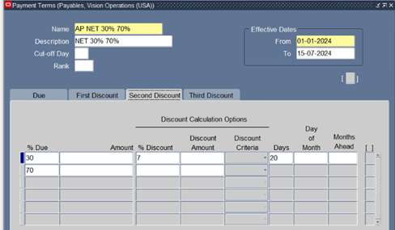
Setup for Accounts payable module
Payment Terms
Define Special Calendar To Create Payment Terms
Setup >Calendar > Special Calendar
Setup >Invoice > Payment terms
7

Slide 8
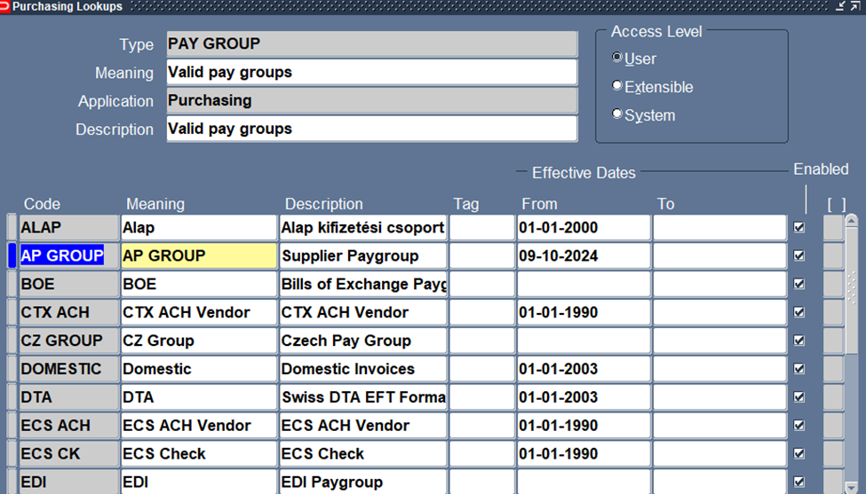
Setup for Accounts payable module
Pay Group
-used to group similar types of
vendors or suppliers for payment
processing.
8

Slide 9
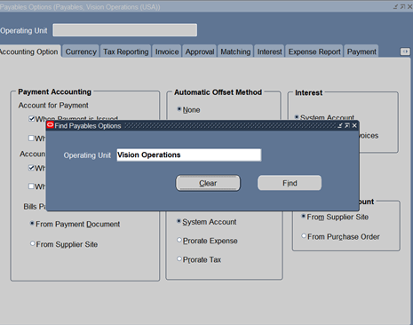
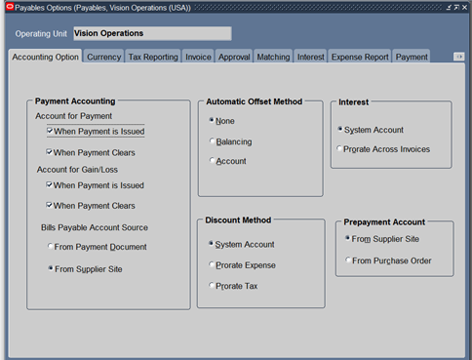
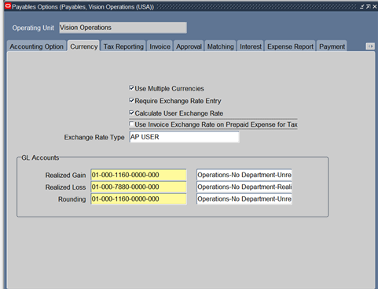
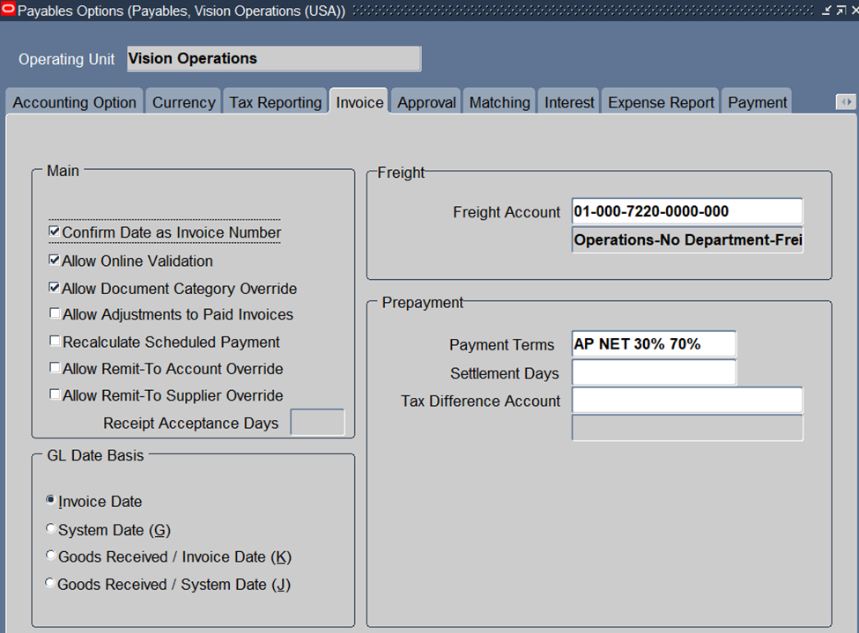
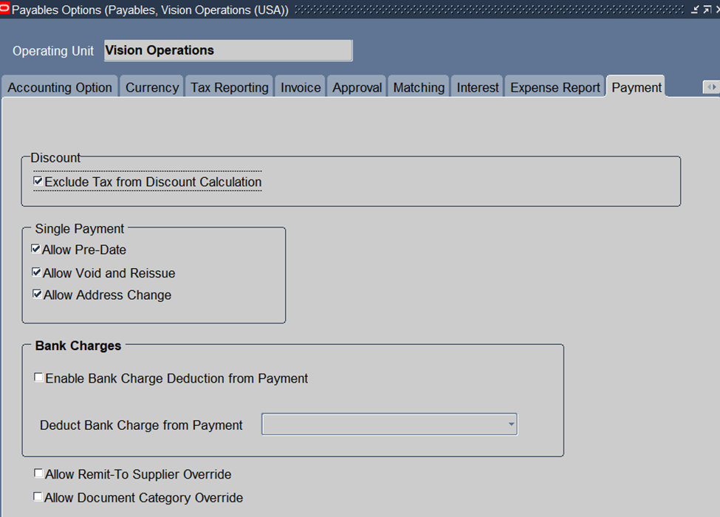
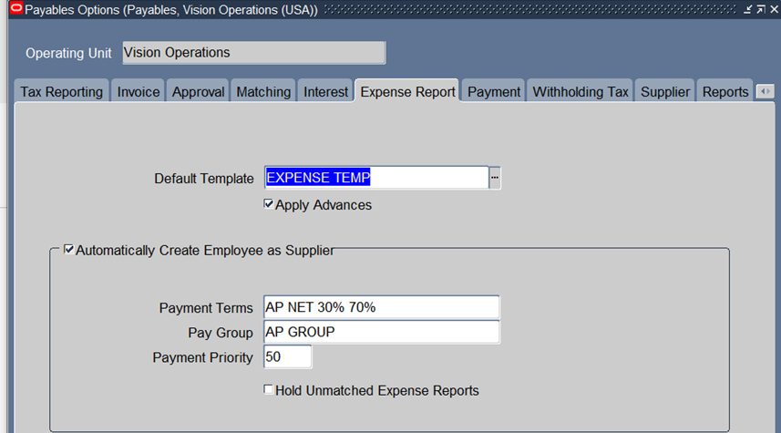
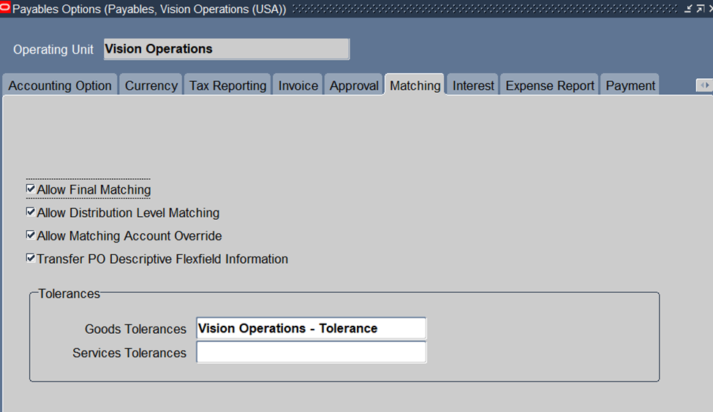
Setup for Accounts payable module
Setup > Options > Payables Options
Choose Vision Operations
Accounting Option
Currency
Invoice
Matching
Expense Report
Payment
9

Slide 10
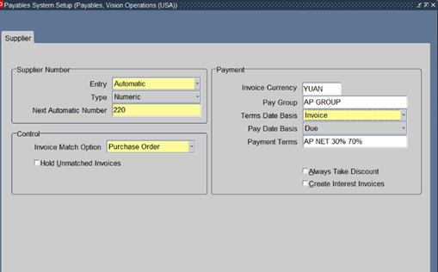
Setup for Accounts payable module
Setup > Options > Payable System Setup
Automatically assign supplier number
This setup is crucial for managing
supplier details and payment
configurations within the Oracle
Payables module
10

Slide 11
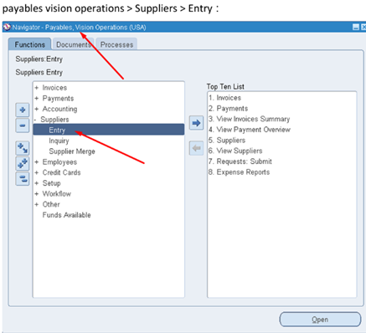
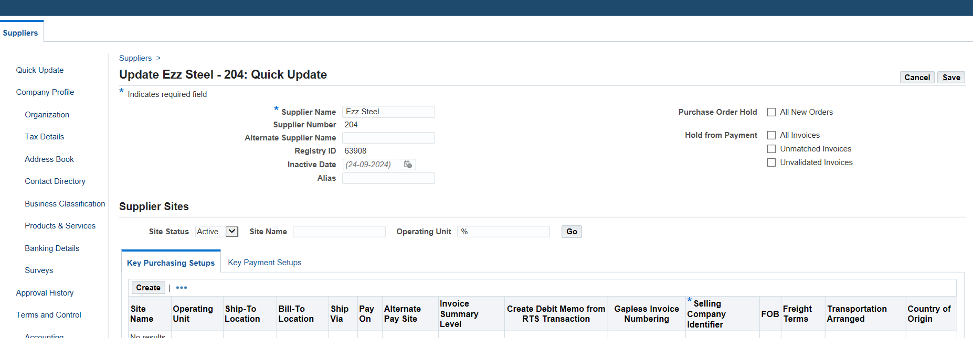
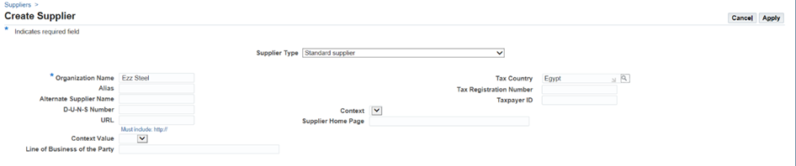
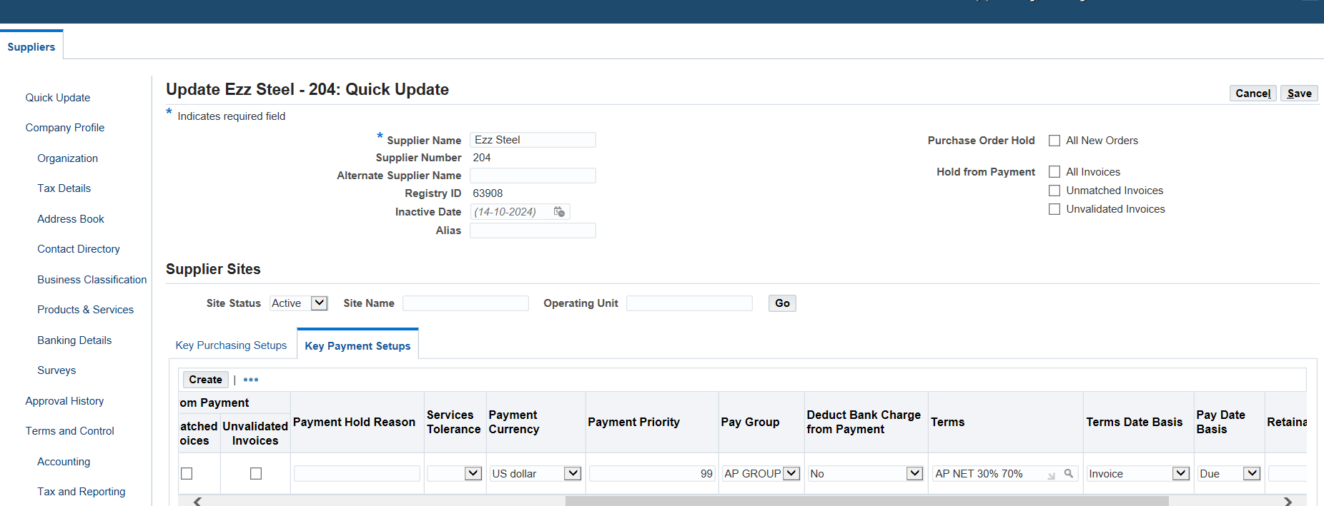
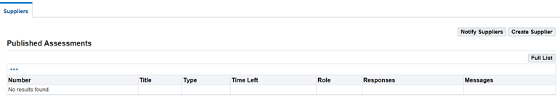
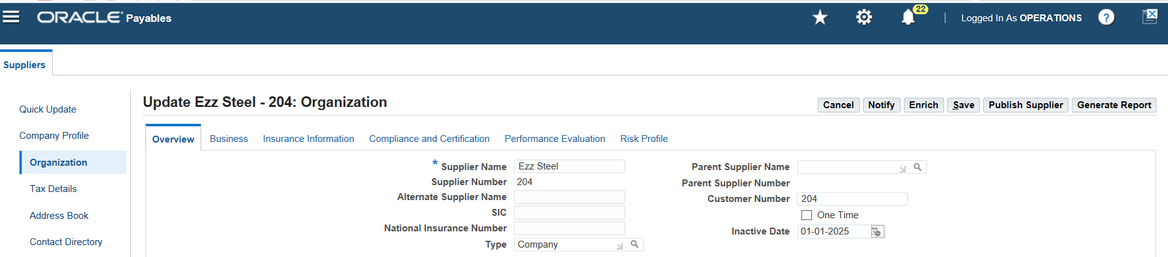
Create and Manage Supplier Invoices
Define Supplier
Payable > Suppliers > Entry
In the Suppliers Summary or the Suppliers detail window
Press On Create supplier
enter a unique Supplier Name
Create Key Purchasing Setups And Key Payment Setups
Organization Type Is Company
11

Slide 12
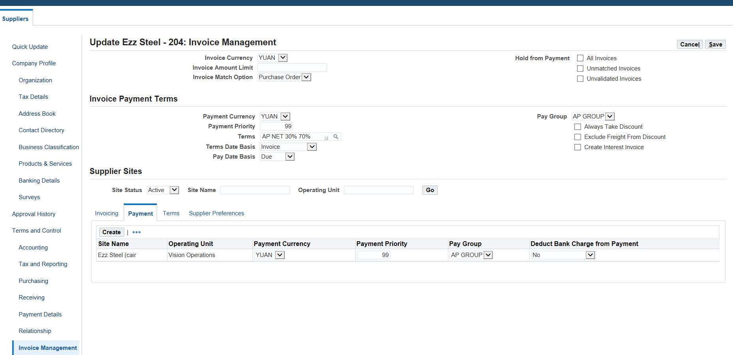
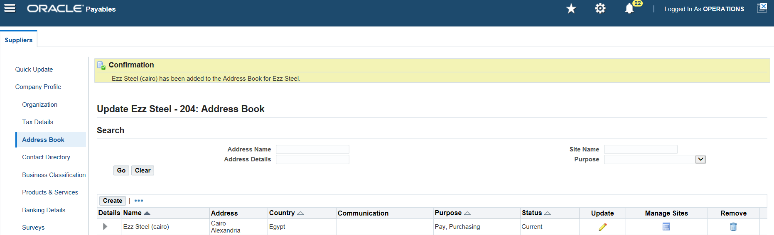
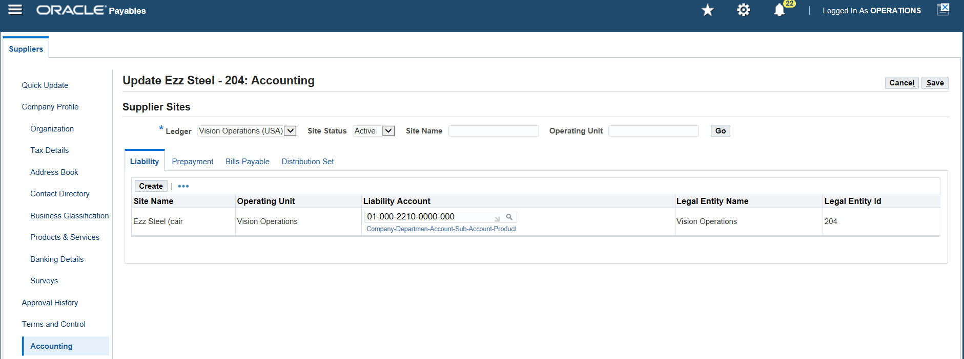
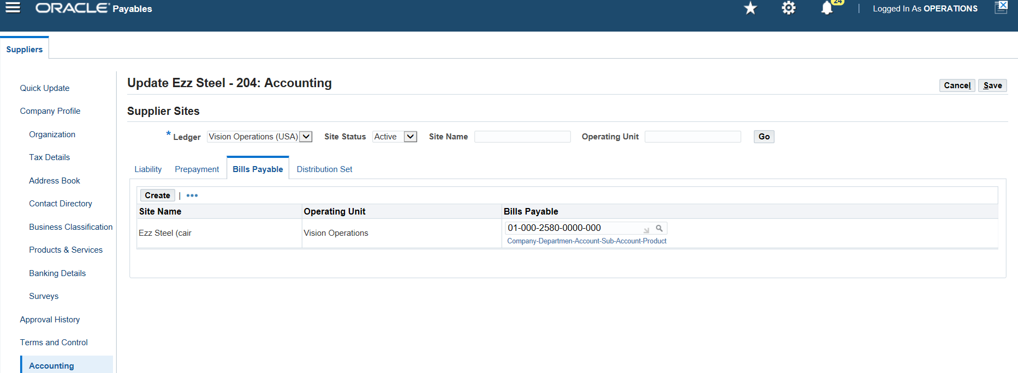
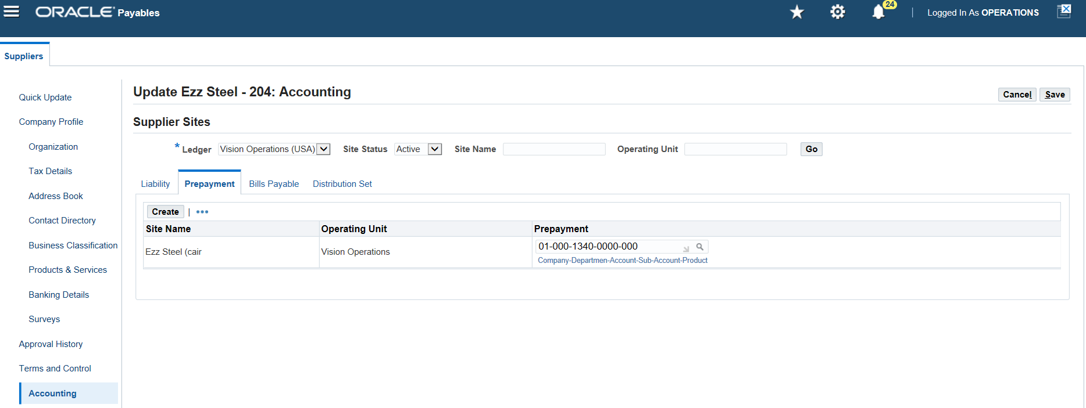
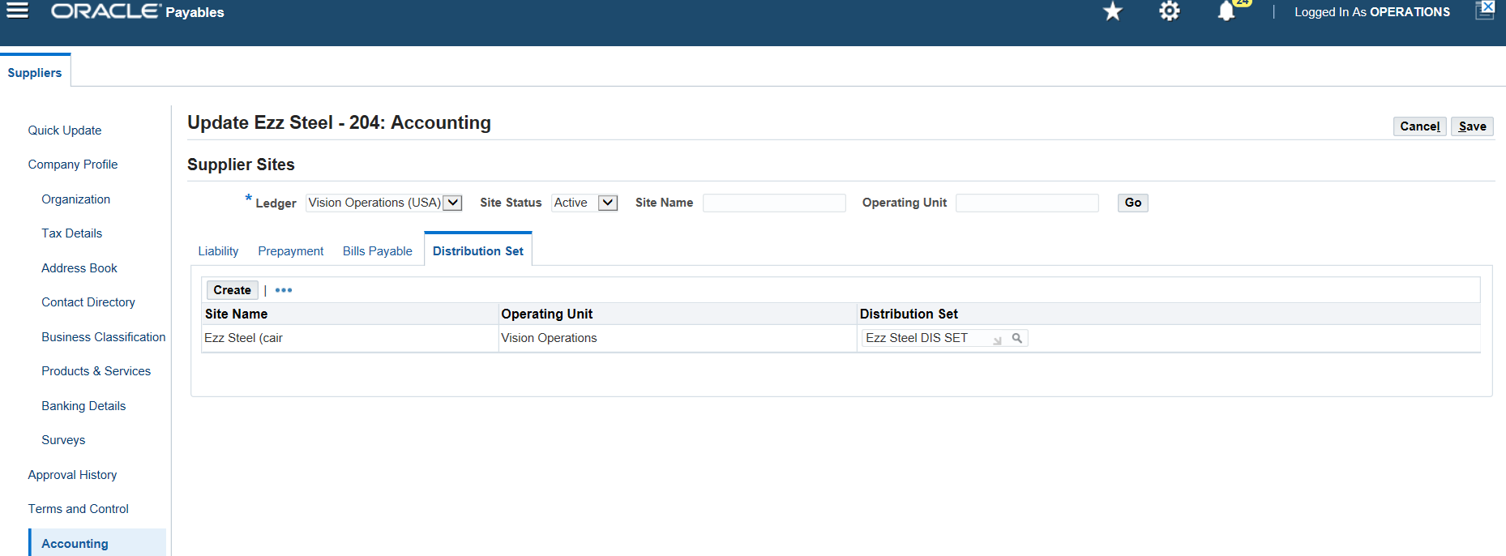
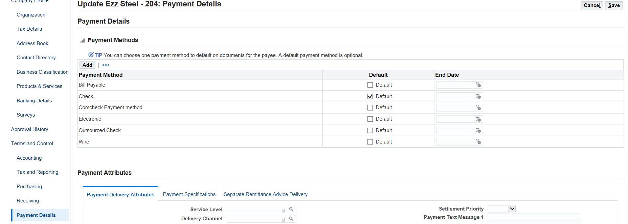
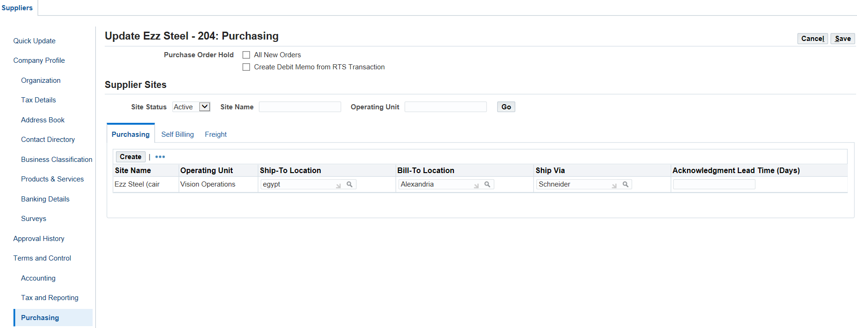
Create and Manage Supplier Invoices
Define Supplier
Click On Adress Book
Click On Accounting
Click On Purchasing
Click On Payment Details
Invoice Management
Enter information about invoice management and invoice payment terms
12

Slide 13
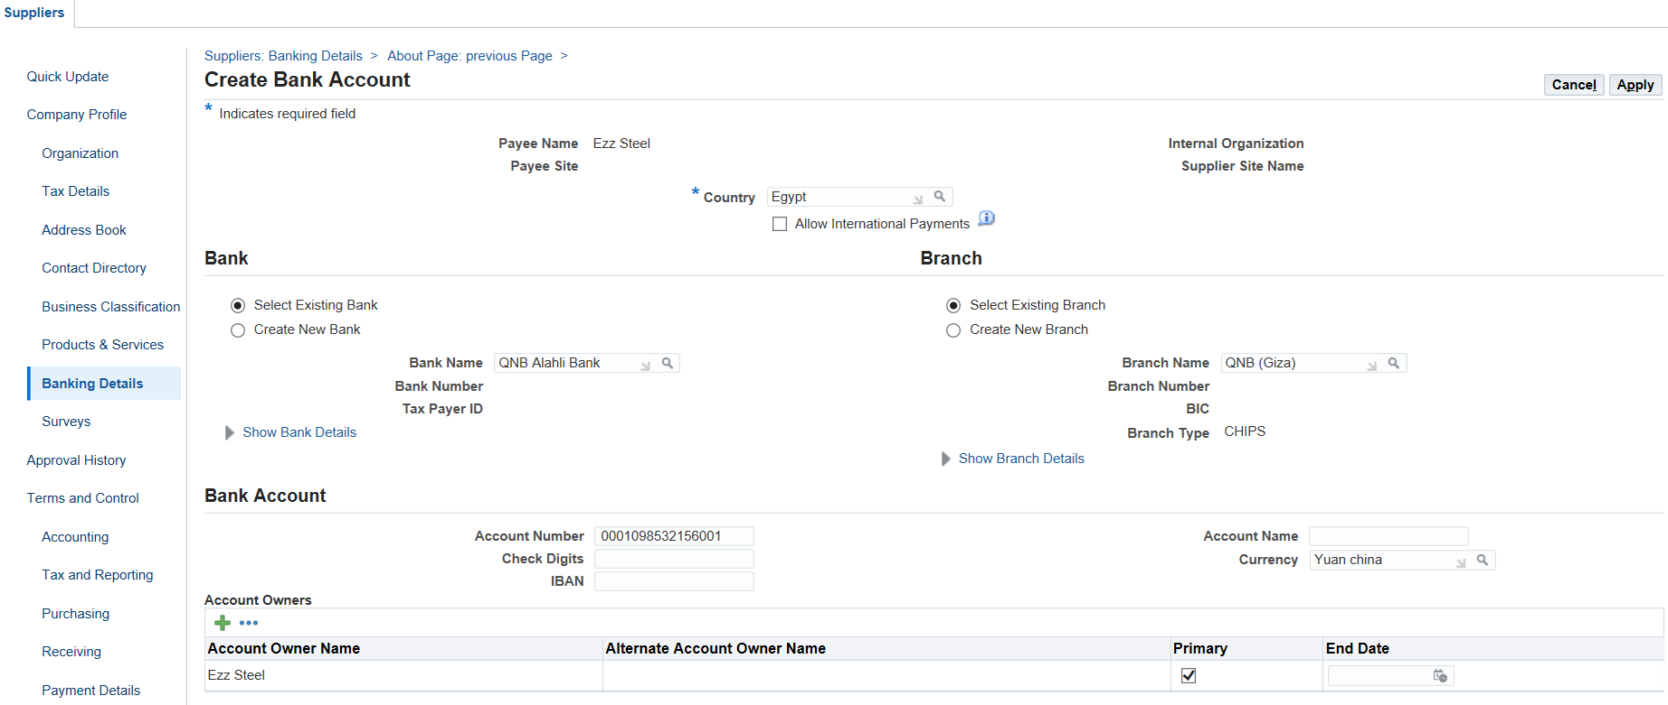
Create and Manage Supplier Invoices
Define Bank Account
Banking details
Create bank account for supplier and click on apply then save
13

Slide 14
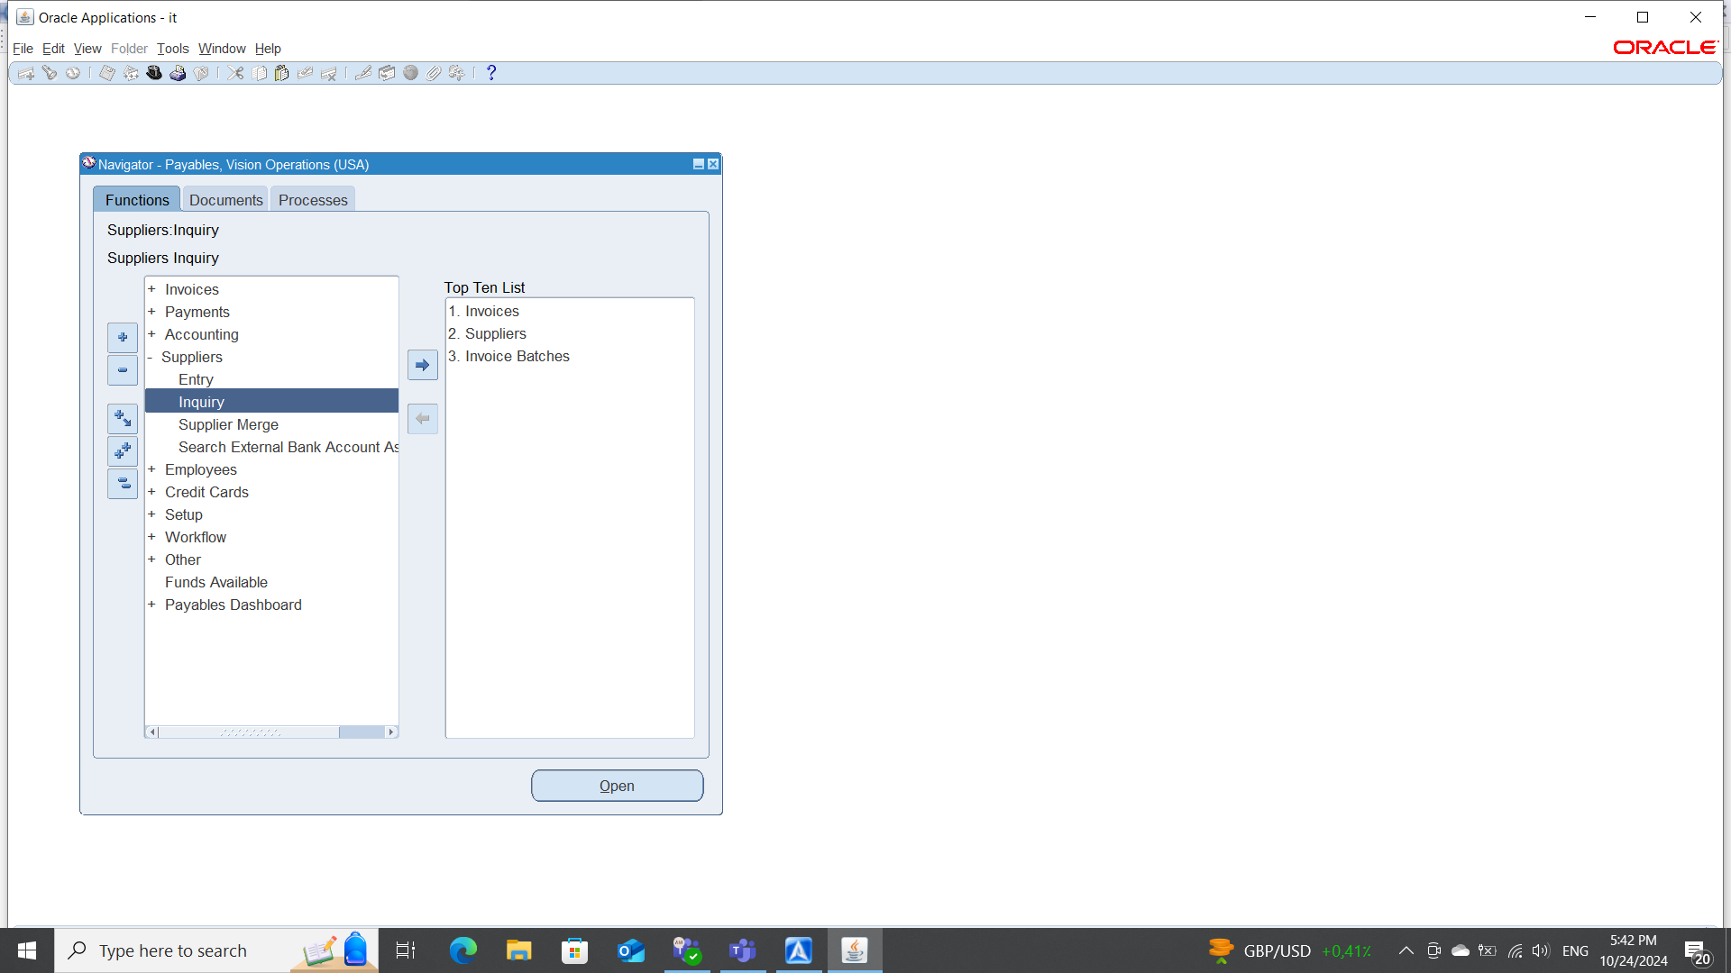
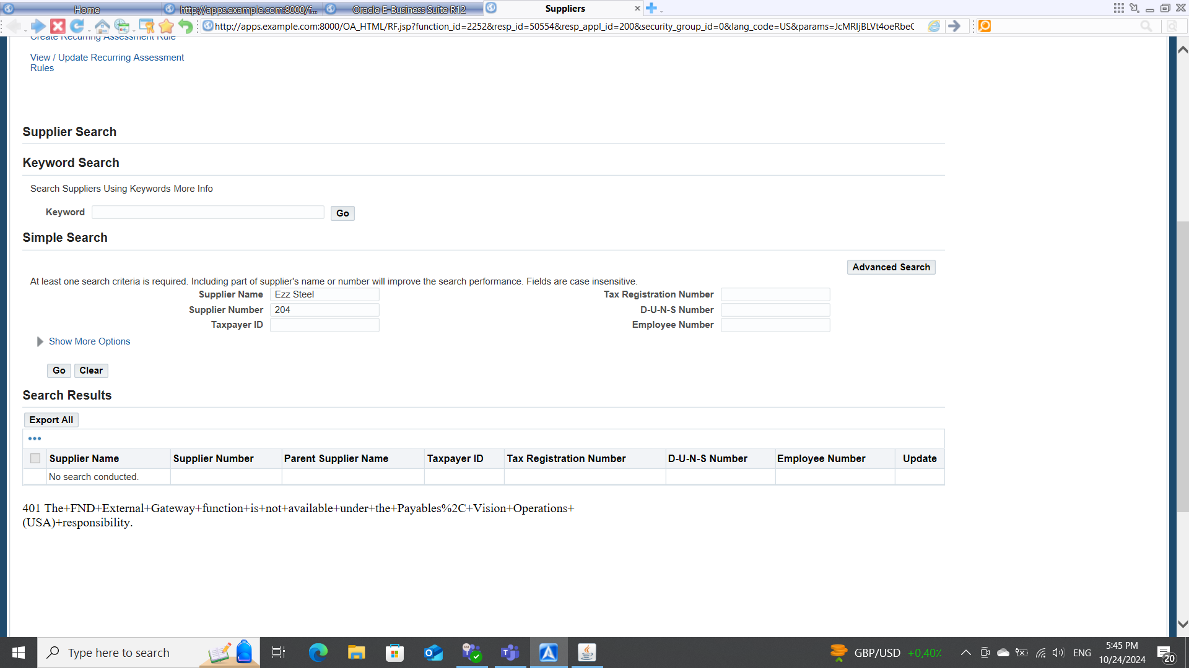
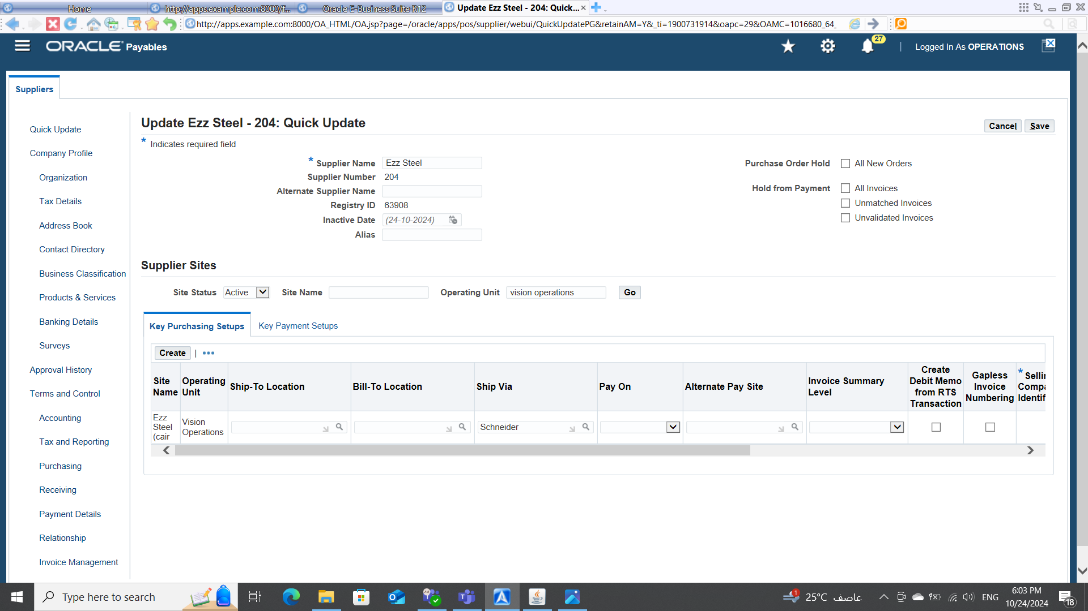
Create and Manage Supplier Invoices
Inquiry Supplier
Payables Vision Operations >suppliers > inquiry
Search For The Supplier "Ezz Steel"
Search about The Supplier Details
14

Slide 15
Vendor Invoices and Billing
Create and Manage Supplier Invoices
Invoice Matching (PO Matching)
Invoice Adjustments and Holds
Supplier Inquiry
15

Slide 16
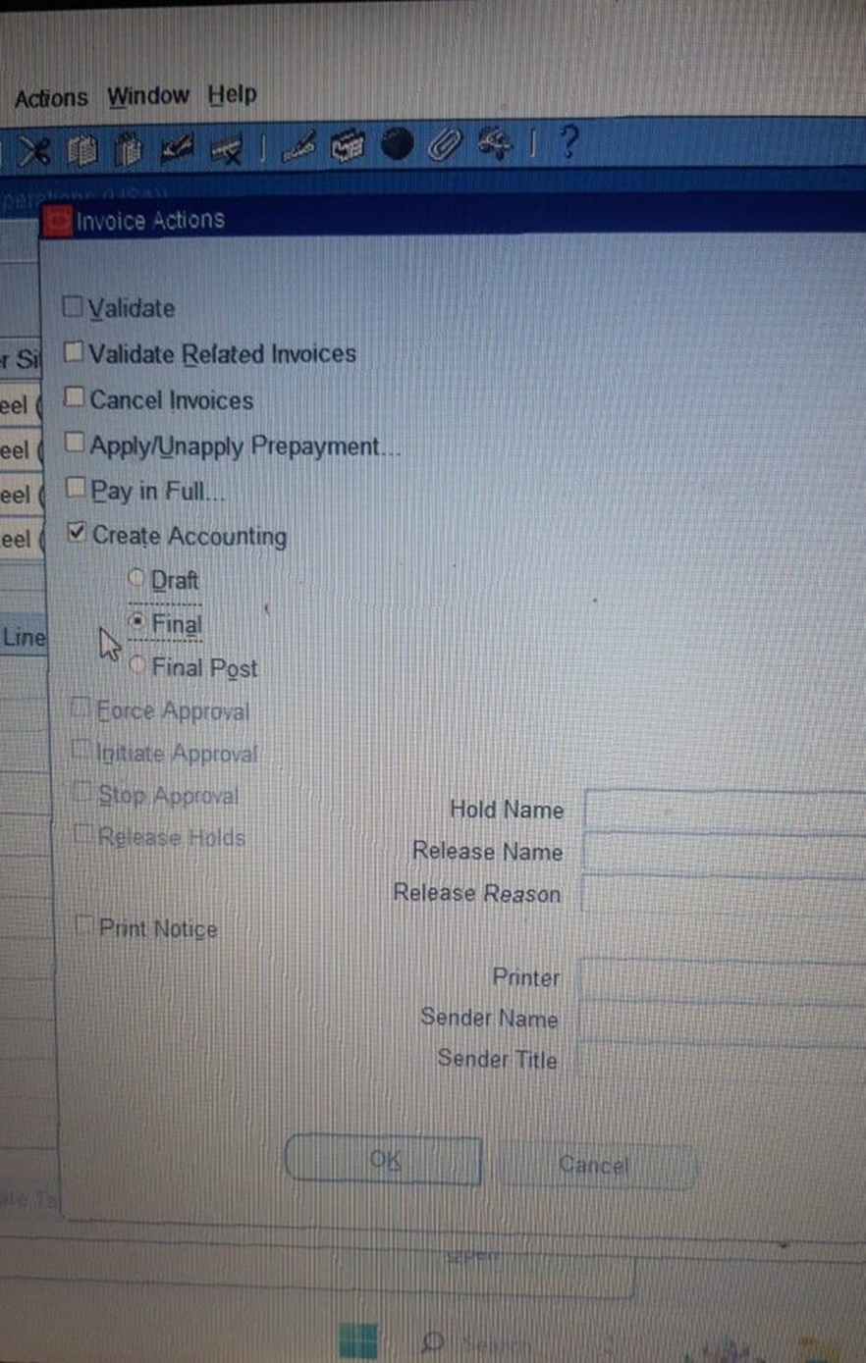
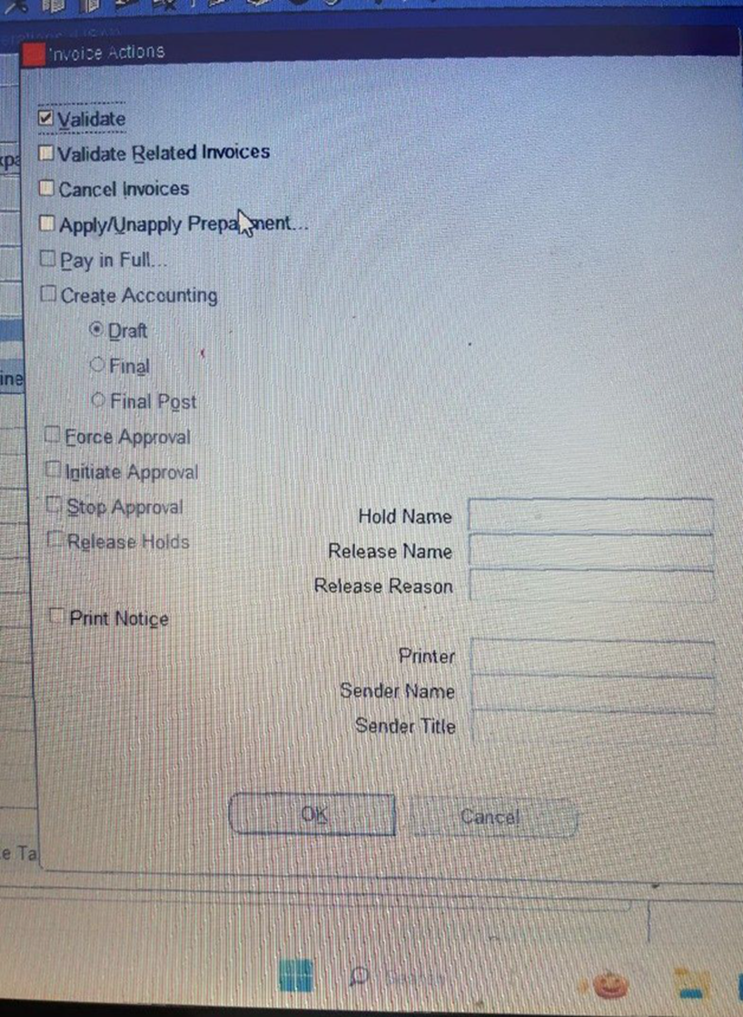
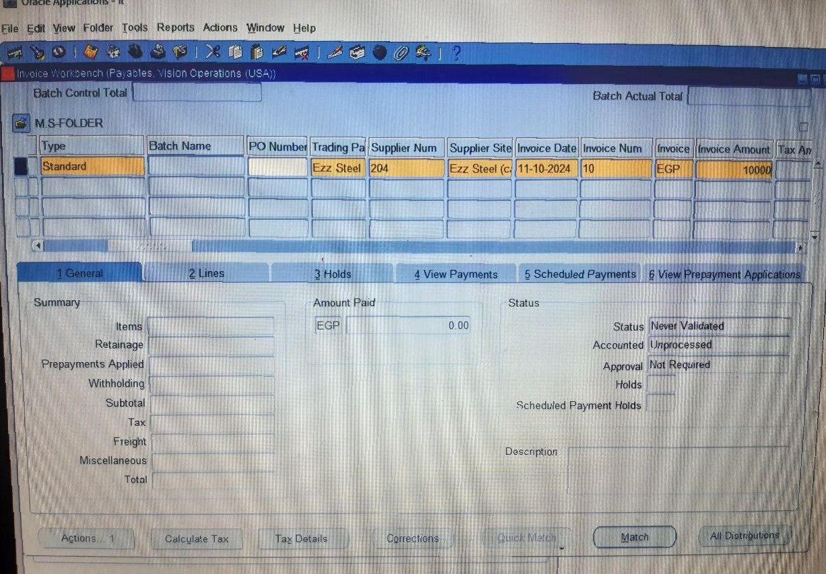
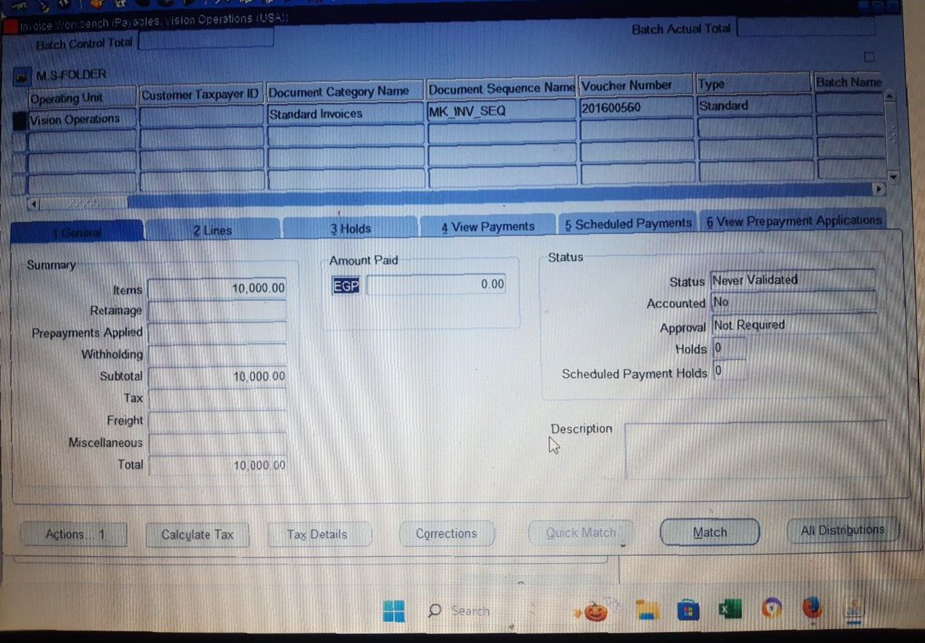
Create and Manage Supplier Invoices
Creating Invoices
Invoices > Enter > Invoices
Create Standard Invoice
Now the Invoice is been matched
《Invoice Amount = Distribution Amount 》
Click on Actions tab for Validation
Action ,Create Accounting , Final ,OK
16

